Slide 1


University Database Managment System
INFORMATION TECHNOLOGY INSTITUTE
Presented By Ibrahim El-Nwasany

Slide 2
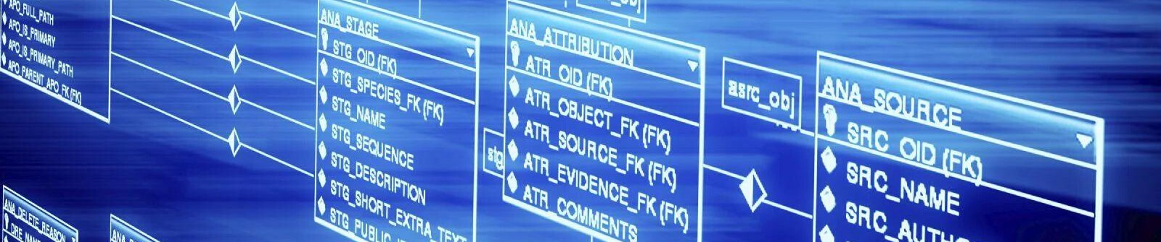
Agenda
1
Designing ERD
6
Creating Functions
2
Mapping and Normalization
7
Backup Script
3
Tables Creations SQL Script
8
Storage Script
4
Creating Procedures
9
Java Implementation
5
Creating Triggers

Slide 3


1- Entity Relationship Diagram
Students
Departments
Courses
Grades
Students_courses(enroll)
Back to Agenda

Slide 4
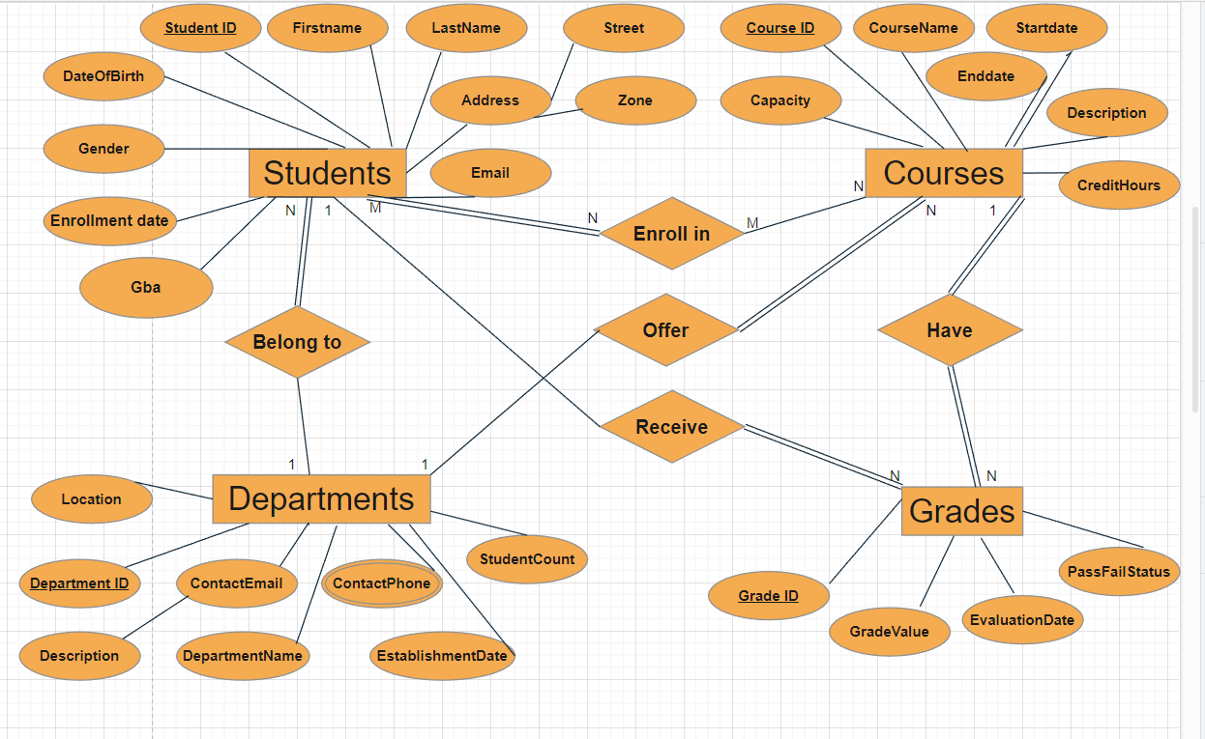

Slide 5
3- Mapping and Normalization
Students(Student_id (pk) , firstname, lastname , gender , email, enrollmentdate , dateofbitrh , street , zone , department_id(fk) )
Courses(course_id(pk),coursename,startdate,enddate,capacity,description,CreditHours,department_id(fk))
Departments(department_id(pk), departmentname, description , location , contactemail, studentcount ,establishmentdate)
Grades(Grade_id,Gardevalue,Evaluationdate,passfailstatus,student_id(fk),course_id(fk)
Departments_phone(department_id(fk),contactphone)
Students_Courses (Student_ID(fk),Course_ID(fk))
Back to Agenda

Slide 6
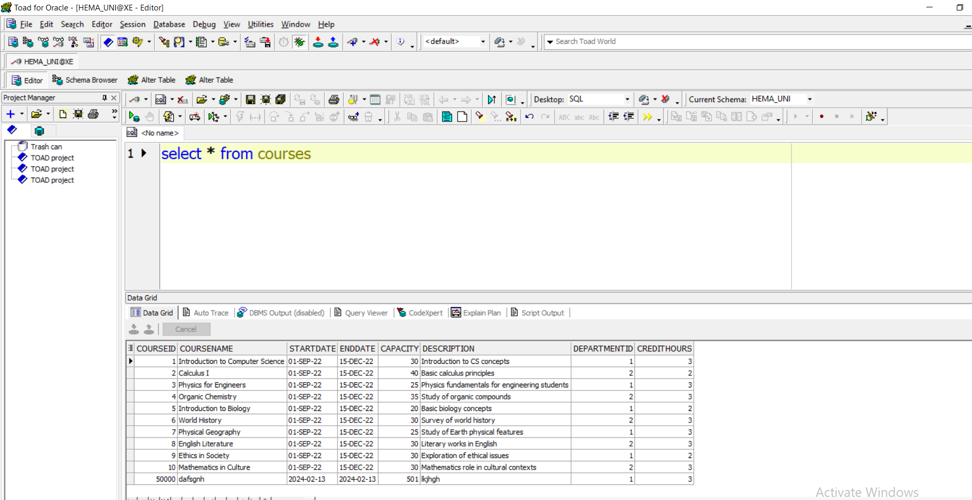
Database Insertion

Slide 7





4- Database Procedures
Procedures For Data Insertion
insertion_student
Goal
This Procedure used for
Insertion New Student
insertion_cousre
Goal
This Procedure is used for
Insertion New Course
Insertion_grades
Goal
This Procedure is used for
Insertion New Grade
Back to Agenda

Slide 8

5- Database Triggers
Triggers For Checking for java needs
Update_gpa_triggeer
Goal
When the gba of student calculated from the function it automatically update gba column with new gba
Back to Agenda

Slide 9


6- Database Functions
Functions For Java Needs
Calculate_gba
Goal
This Function used for
Calculate gba for each student
based on gradevalue and
credithours for each course
Calculate_avg_gba
Goal
This Function is used for calculate average gba student grades for
every single course the average
gba for each course
Back to Agenda

Slide 10
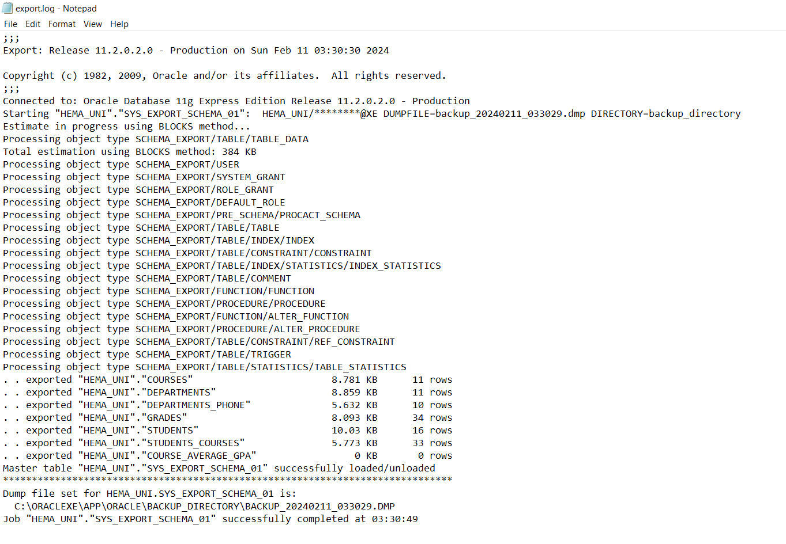
Backup

Slide 11
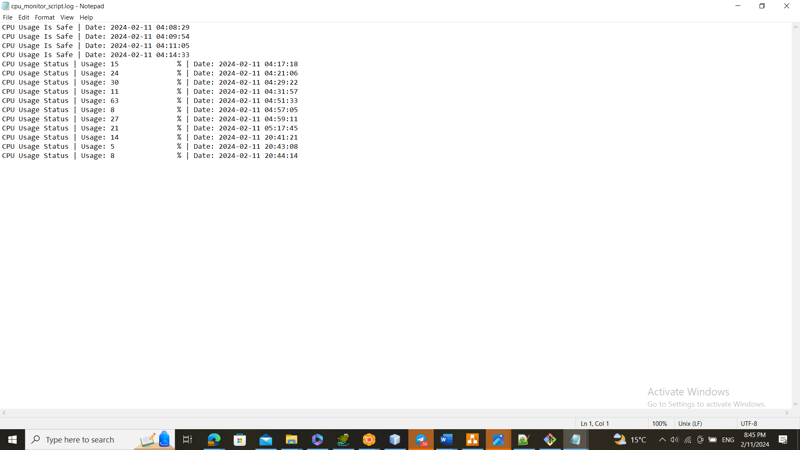
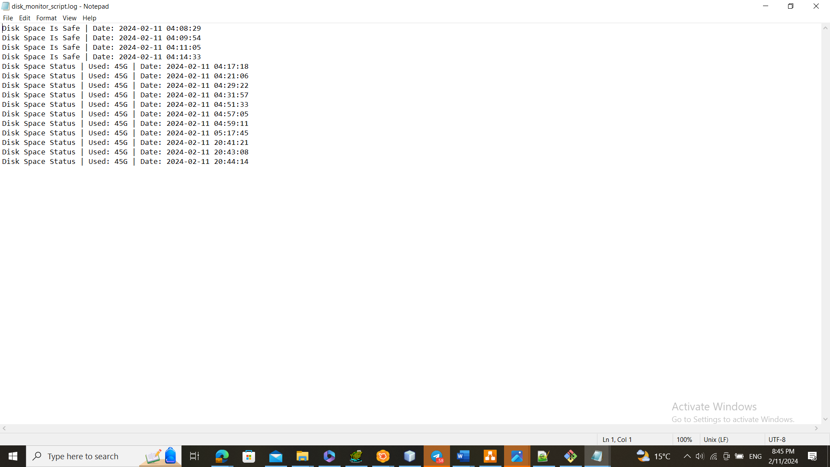
Disk Monitor

Slide 12
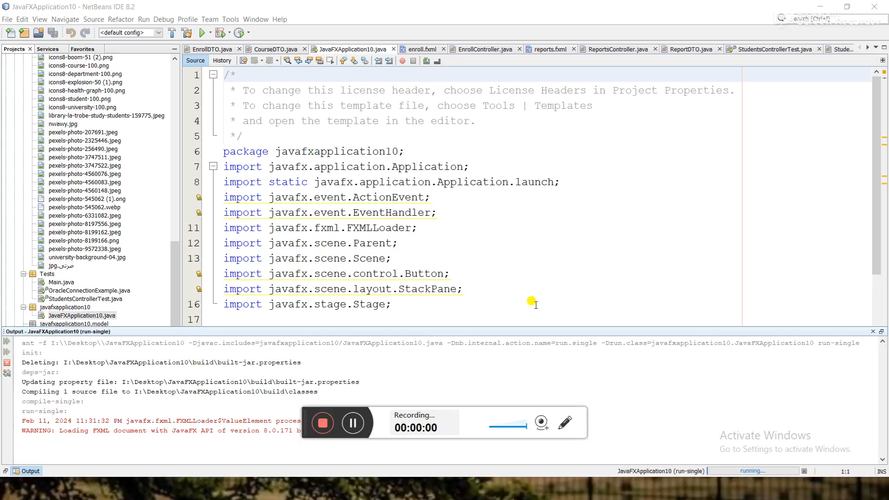
Anomalies Checks

Slide 13





Thank You !

